Slide 1
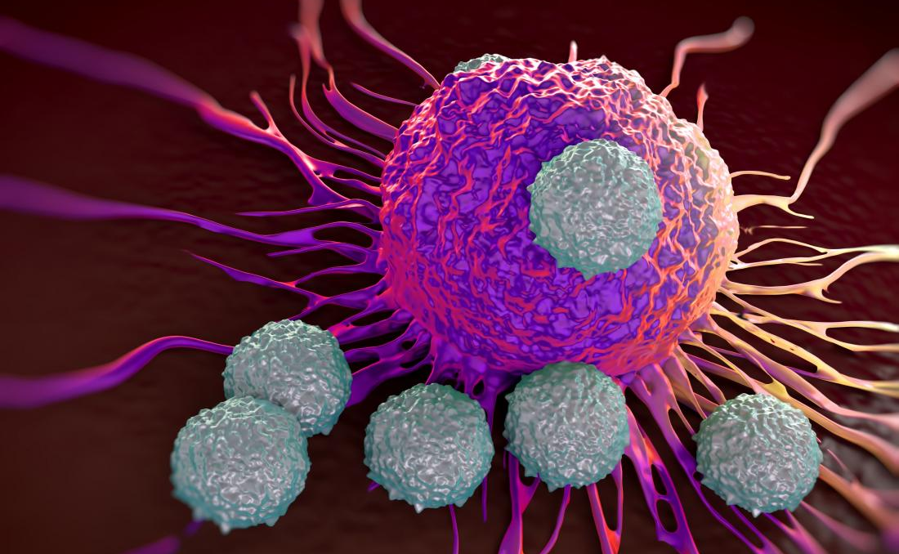
BS20001 | Science of Living Systems
Cell Cycle, Apoptosis and Cancer
Abhijit Das | School of Bio Science | IIT Kharagpur
Email: abhijit.das@iitkgp.ac.in | Tel: 03222-260511

Slide 2
Cell Cycle Alternates Between Mitosis (M) and Interphase (G1, S, G2)
Interphase – long period between two divisions during which cells grow, duplicate chromosomes and prepare for division
G1 (Gap phase 1) – from birth of cell to the onset of chromosome duplication.
S (Synthesis phase) – replication of DNA leading to chromosome duplication (formation of sister chromatids)
G2 (Gap phase 2) – end of chromosome duplication to the onset of mitosis.
M: Mitosis phase – nuclear division follows division of cytoplasmic content (cytokinesis) to separate sister chromatids into daughter cells
G0: resting phase – differentiated cells exit from cell cycle and survive for days or years
Notes:
2

Slide 3
Cell cycle control system
Are there DNA replication errors
The eukaryotic cell cycle control system has three major checkpoints as surveillance mechanism for cell cycle progression or transitions :
Start or restriction point (between G1 and S)
G2/M checkpoint
Metaphase/anaphase transition

Slide 4
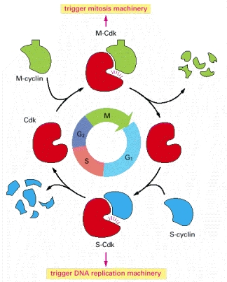
Cyclins & cyclin-dependent kinases (Cdks): central components of the cell cycle control system
Central component of cell cycle control system are cyclin-dependent kinases (Cdks). Their activities rise and fall as the cell progresses through its cycle.
This leads to cyclical changes in the phosphorylation of proteins that control major cell cycle events.
Cdk activity is primarily controlled by Cyclin proteins. Cdks are active only when they tightly bind Cyclin.
The levels of cyclin proteins periodically rise and fall which result in periodic activation and deactivation of the Cdks.

Slide 5
Different classes of cyclins undergo cyclical synthesis and degradation
Cyclin concentration
Three classes of cyclins are required in all eucaryotic cells:
G1/S-cyclins bind Cdks at the end of G1 and commit the cell to DNA replication.
S-cyclins bind Cdks during S phase and are required for the initiation of DNA replication.
M-cyclins promote the events of mitosis.
In most cells, a fourth class of cyclins, the G1-cyclins, helps promote passage through Start or the restriction point in late G1.

Slide 6
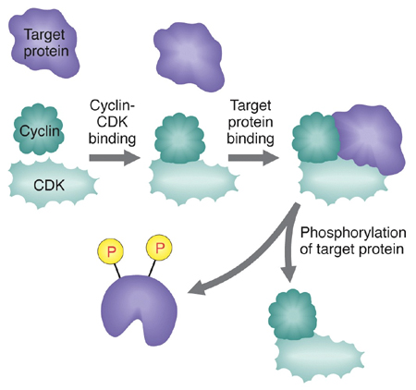
Cyclin-Cdk complex activates various targets by phosphorylation
Binding with Cyclin activates Cdks
Active Cdks have many target proteins which are activated by phosphorylation

Slide 7



What happens when cell cycle regulation goes wrong?
Uncontrolled proliferation- TUMOUR
Cell division without checking for DNA damage-
DNA replication errors are not corrected
DNA damage due to external mutagens are not corrected
ACCUMULATION OF MUTATIONS IN GENOME
Error rate of DNA Polymerase= 1 in 10⁵ nucleotides
A human cell has 6 billion base pairs
So 1 round of replication of the human genome will make 120,000 errors!!!
How are those errors repaired?
During replication: DNA Polymerase has proofreading activity
After replication: A well designed DNA repair machinery repairs the damage
If the DNA damage is beyond repair, the cell dies by initiating Apoptosis

Slide 8
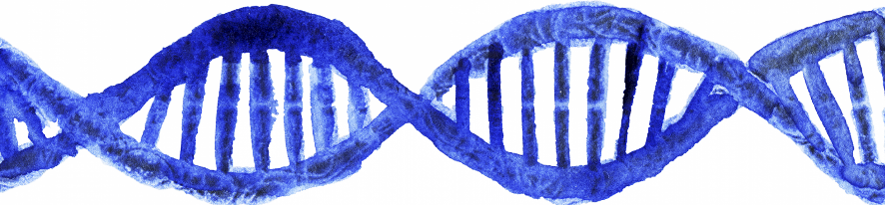
What happens when DNA is damaged?
Replication errors
Ionizing Radiation
UV exposure
Mutagenic chemicals
ROS
Cigarette smoking
Cell cycle pauses at Checkpoint
DNA repair programme
Apoptosis (Programmed Cell Death)

Slide 9
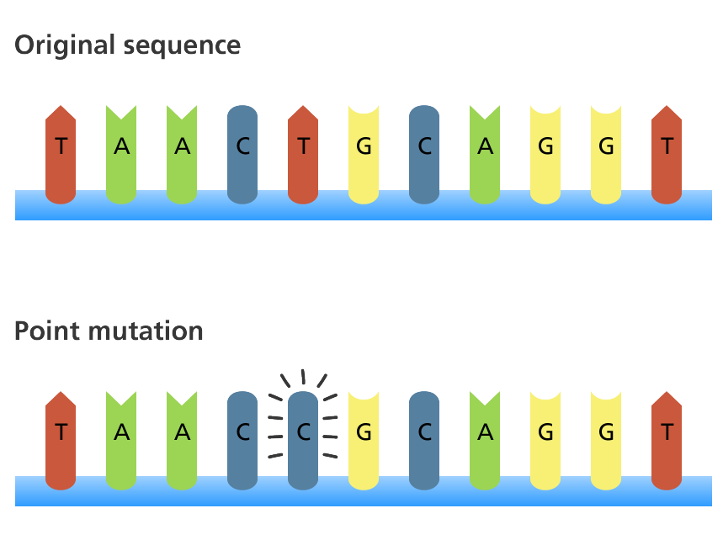
What is a mutation?
A mutation is an alteration in the nucleotide sequence of the genome of an organism
Mutation in a gene results in alteration in the protein product
Spontaneous mutations: due to replication error
Induced mutations: caused by mutagens
Mutagen: a physical or chemical agent that changes the DNA sequence
Examples: radiation (UV, X ray etc.), tobacco, chemical agents
Carcinogen: a substance or agent that promotes carcinogenesis or cancer formation
Examples: Asbestos, tobacco smoke, aflatoxin, arsenic, radiation, food colors, certain viruses etc.
Notes:
https://www.nature.com/scitable/topicpage/dna-replication-and-causes-of-mutation-409/

Slide 10
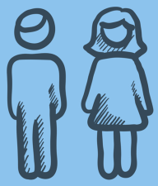
Germline mutations vs Somatic Mutations
Spermatogenesis
Oogenesis
Germline mutation
Zygote
Mutation in gamete genome
Somatic mutation
Ovum
Sperms
fertilization
Somatic mutation
Zygote
Mutation transmitted to progeny
Mutations may lead to Cancer

Slide 11
What causes cancer?- Gene Mutations
Tumor Suppressor Genes:
Products are involved in
Cell cycle regulation
DNA repair
Cell death
Loss-of-function mutation leads to uncontrolled cell division
Proto-oncogenes:
Products are involved in
Growth regulation
Regulation of cell division
Cellular communication
Cell death
Gain-of-function mutation converts them to Oncogenes, which leads to uncontrolled cell division
About One Percent of the Genes in the Human Genome Are Cancer-Critical
Notes:
How Proto-Oncogenes Become Oncogenes
Today, more than 40 different human proto-oncogenes are known. But what types of mutations convert these proto-oncogenes into oncogenes? The answer is simple: Oncogenes arise as a result of mutations that increase the expression level or activity of a proto-oncogene. Underlying genetic mechanisms associated with oncogene activation include the following:
Point mutations, deletions, or insertions that lead to a hyperactive gene product
Point mutations, deletions, or insertions in the promoter region of a proto-oncogene that lead to increased transcription
Gene amplification events leading to extra chromosomal copies of a proto-oncogene
Chromosomal translocation events that relocate a proto-oncogene to a new chromosomal site that leads to higher expression
Chromosomal translocations that lead to a fusion between a proto-oncogene and a second gene, which produces a fusion protein with oncogenic activity
https://www.nature.com/scitable/topicpage/proto-oncogenes-to-oncogenes-to-cancer-883/

Slide 12
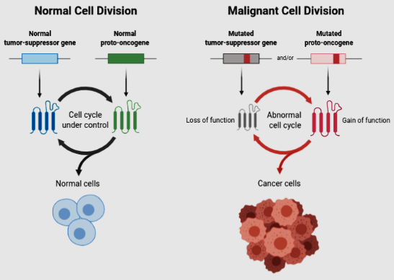

Slide 13

Role of tumour suppressor gene p53
p53
GUARDIAN
OF
THE
GENOME
Normal cell division does not depend on p53 protein
DNA damage – rise in P53 level:
(i) cell cycle arrest for DNA repair
or
(ii) Induction of cell death
DNA damage and p53 absent-
no cell cycle arrest
and
(ii) no apoptosis
the cell continues to divide with DNA damage/genetic abnormality
Notes:
Model for the function of p53.
( a ) Cell division does not normally require the involvement of p53. ( b ) If, however, the DNA of a cell becomes damaged as the result of exposure to mutagens, the level of p53 rises and acts either to arrest the progression of the cell through G 1 or to direct the cell toward apoptosis. ( c ) If both copies of the TP53 gene are inactivated, the cell loses the ability to arrest the cell cycle or commit the cell to apoptosis following DNA damage. As a result, the cell either dies from mitotic failure or continues to proliferate with genetic abnormalities that may lead to the formation of a malignant growth.

Slide 14
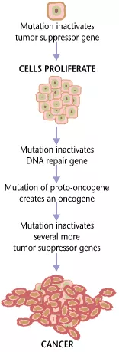
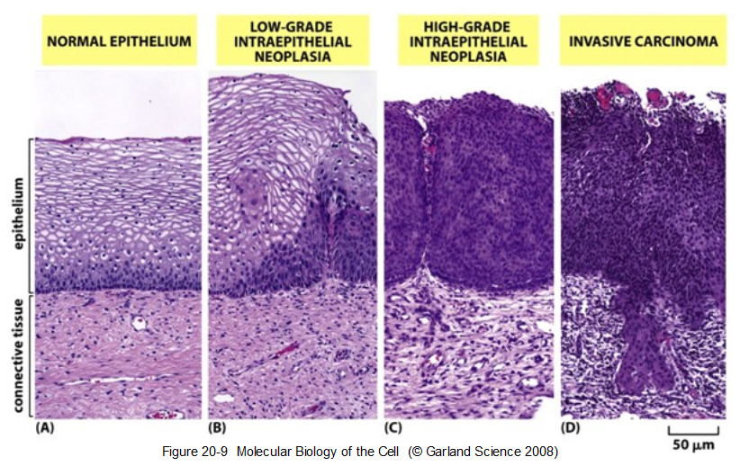
Cancer is a multistep process: in each step accumulating mutations and altering cells properties

Slide 15
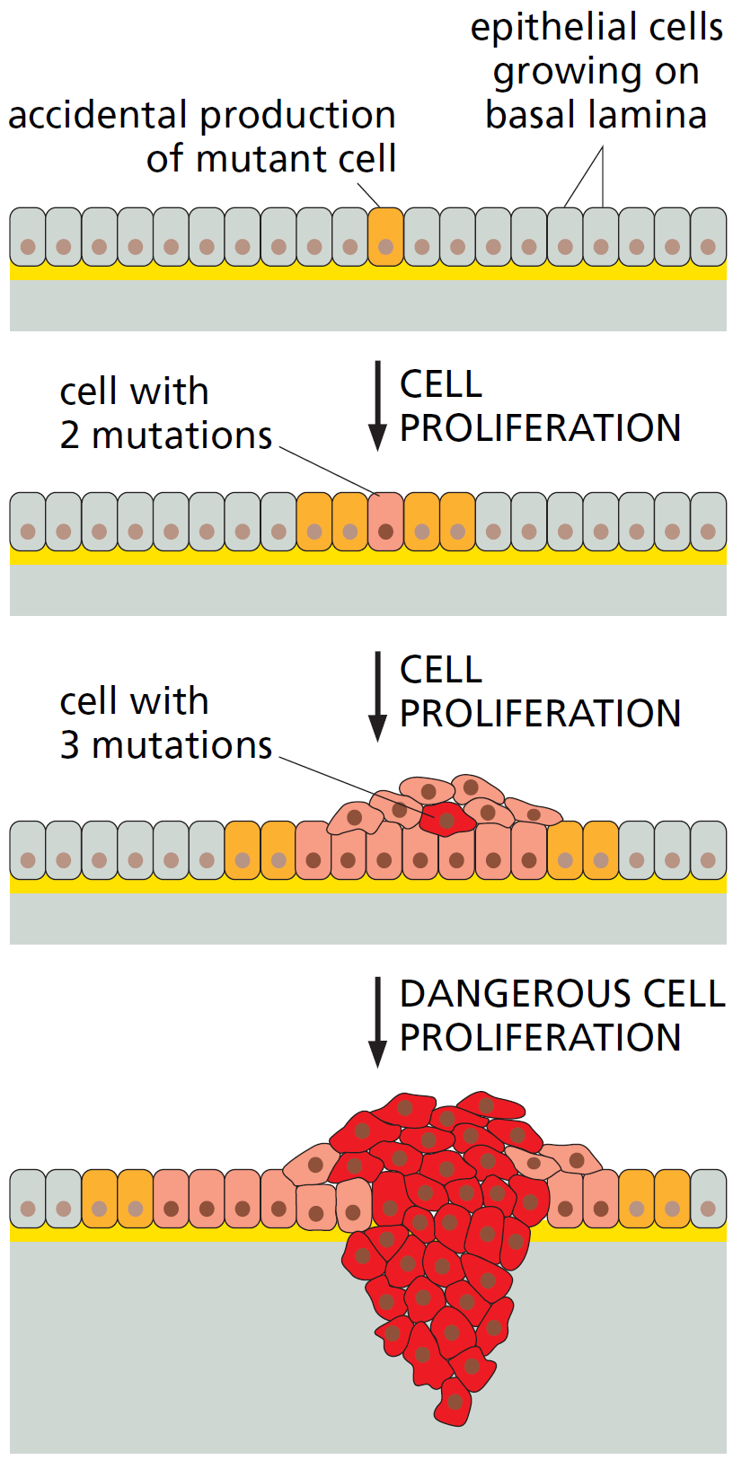
1. Development of Tumor
Hallmarks of Cancer

Slide 16
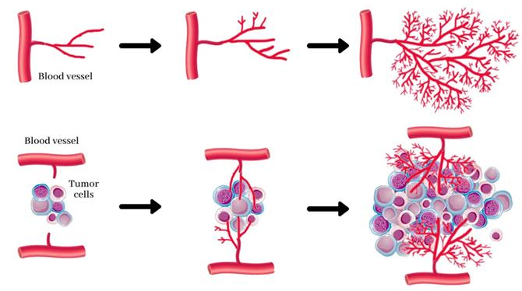
2. Angiogenesis: Formation of blood vessels in tumour
Hallmarks of Cancer
Normal angiogenesis
Tumour-induced angiogenesis

Slide 17
3. Immortalization: Evading Apoptosis
Hallmarks of Cancer
Dividing cell
Dividing cell
DNA Damage
DNA Damage
High p53
No p53
Cell cycle arrest
No cell cycle arrest
Uncontrolled cell division
or
DNA damage repaired
Induction of Apoptosis
Normal cell division
(If DNA damage is beyond repair)
No DNA damage repair
No Apoptosis
Daughter cells
Tumour

Slide 18
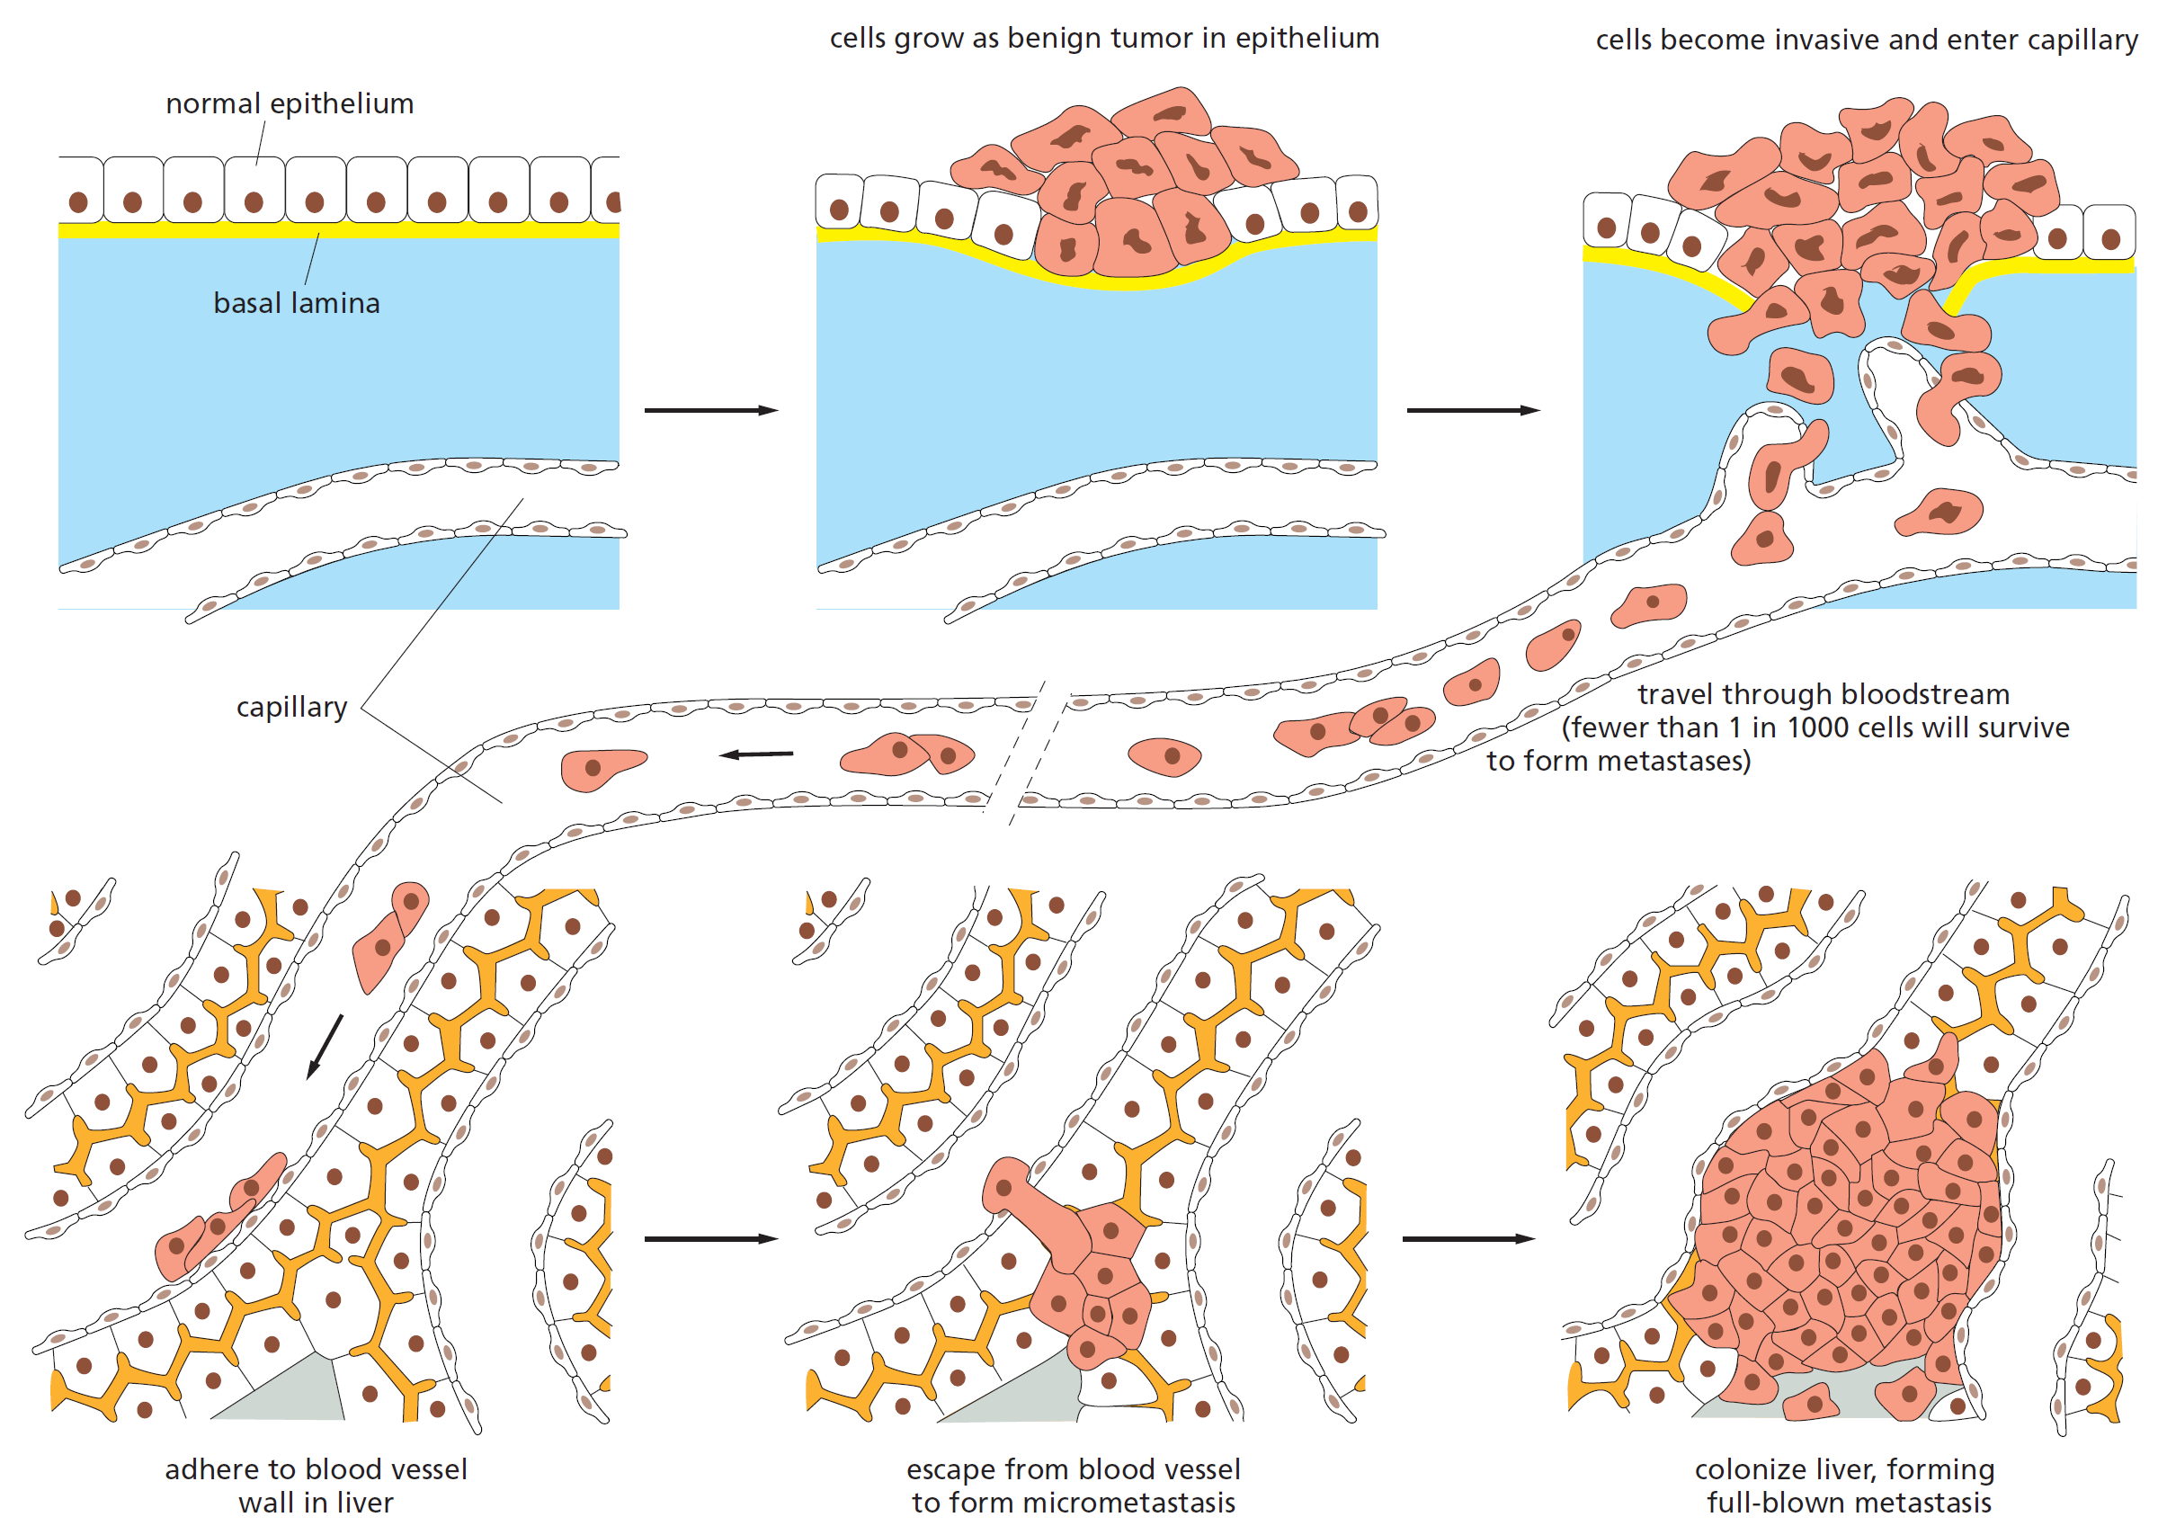
4.Metastasis Invasion and tumor formation at a new site
Hallmarks of Cancer
Notes:
Steps in the process of metastasis. This example illustrates the spread of a tumor from an organ such as the bladder to the liver. Tumor cells may enter the bloodstream directly by crossing the wall of a blood vessel, as diagrammed here, or, more commonly perhaps, by crossing the wall of a lymphatic vessel that ultimately discharges its contents (lymph) into the bloodstream. Tumor cells that have entered a lymphatic vessel often become trapped in lymph nodes along the way, giving rise to lymph-node metastases.
Studies in animals show that typically far fewer than one in every thousand malignant tumor cells that enter the bloodstream will colonize a new tissue so as to produce a detectable tumor at a new site

Slide 19
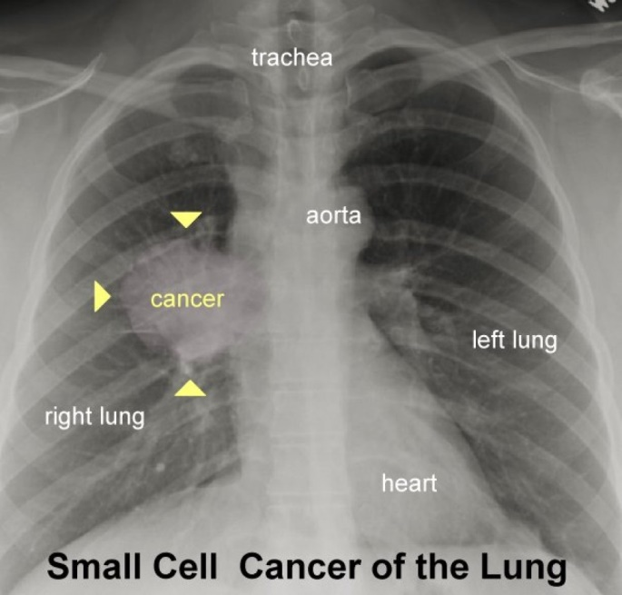
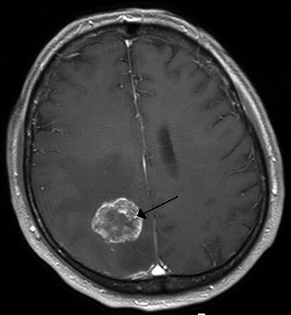
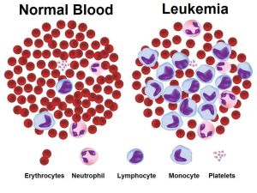
Images of different cancers
Brain tumour

Slide 20
Hallmarks of Cancer Cells
Uncontrolled mitotic division- TUMORIGENESIS
Invade healthy tissue- METASTASIS
UNRESPONSIVE to cell-cell communications
Loss of adhesion to other cells or tissues- LOSS OF CONTACT INHIBITION
Evasion of cell death signals- IMMORTALIZATION
Induce formation of blood vessels- ANGIOGENESIS

Slide 21
Apoptosis: Programmed Cell Death (PCD)
An orderly cellular self destruction pathway

Slide 22
Apoptosis / Programmed Cell Death (PCD)
Evolutionarily conserved
Occurs in all multicellular animals studied (plants too)
Stages and genes conserved from nematodes (worms)
and flies to mice and humans
In contrast to apoptosis, the animal cells that die accidentally in response to an acute injury (e.g. trauma or lack of blood supply) or pathogen infection by a process called cell necrosis.

Slide 23
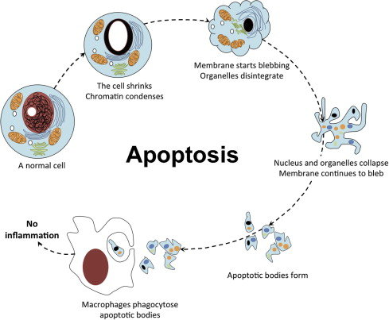
Apoptosis / Programmed Cell Death (PCD)
Apoptosis is an orderly cellular self destruction pathway
When DNA damage is not immediately repaired, the cells kill themselves by apoptosis
In absence of apoptosis the cell can accumulate cancer-promoting mutation
Death signal
(Intrinsic or extrinsic)
Apoptosis is an essential and critically important part for organism’s growth and development
Apoptosis eliminates unwanted cells during organ formation / early development

Slide 24
Caspase: mediator of apoptosis
These are cysteine-aspartic proteases.
Cysteine in the enzyme active site nucleophilically attacks and cleaves a target protein only after an aspartic acid residue.
Caspases are synthesized as inactive pro-caspases and activated following an appropriate stimulus.
Initiator caspases activated auto-proteolytically.
Executive caspases are activated by initiator caspases
There are 12 caspases reported in human.

Slide 25
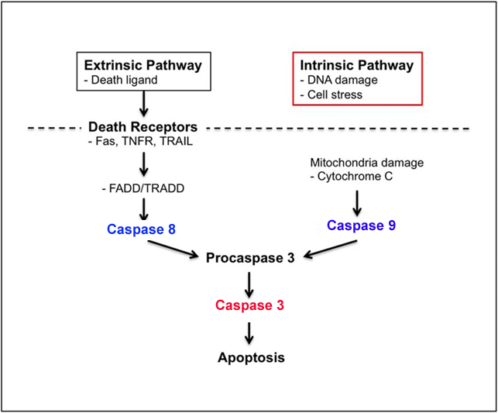
Two classical pathways of apoptosis
Initiator Caspases
Caspases 8, 9
Executive Caspases
Caspase 3

Slide 26
Necessities or Functions of PCD / Apoptosis
PCD/ Apoptosis eliminates unwanted cells during organ formation / early development.
Digits formation in mouse paw during embryonic development
Removal of tail as tadpole changes into a frog
Whenever there are damages in cell organelles, these are recognized very fast and repaired. If the damage is not repairable, the cells undergo apoptosis. E.g. DNA damage by various means, if not immediately repaired, it may lead to cancer-promoting mutation. These defective cells kill themselves by apoptosis

Slide 27
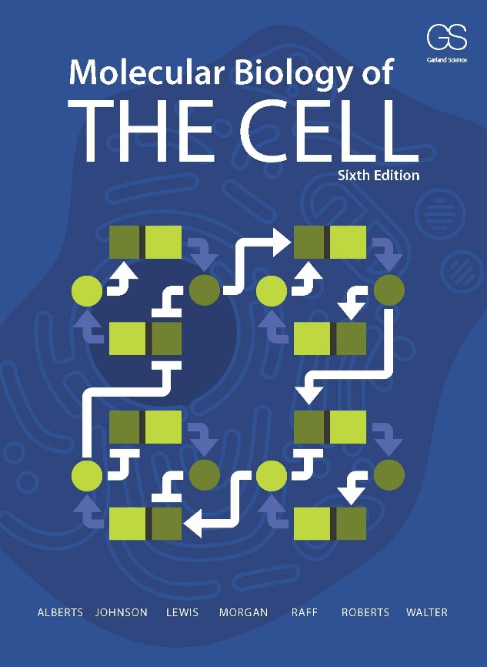
Reading and references

